Slide 1
DNA methylation data analysis for whole-genome bisulfite sequenced primary human α/β cells
Verda Agan
Hodges Lab

Slide 2
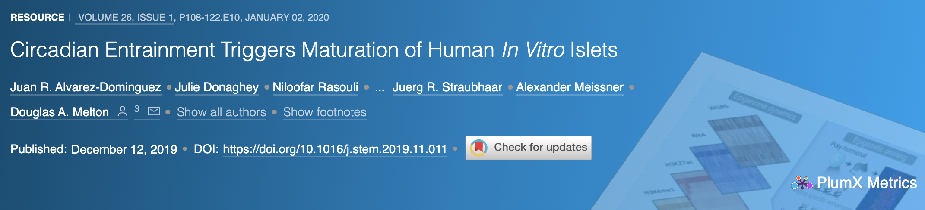
﻿The ChIP-seq, ATAC-seq, WGBS, and RNA-seq data generated during this study are available at NCBI GEO accession number: GSE139817

Slide 3
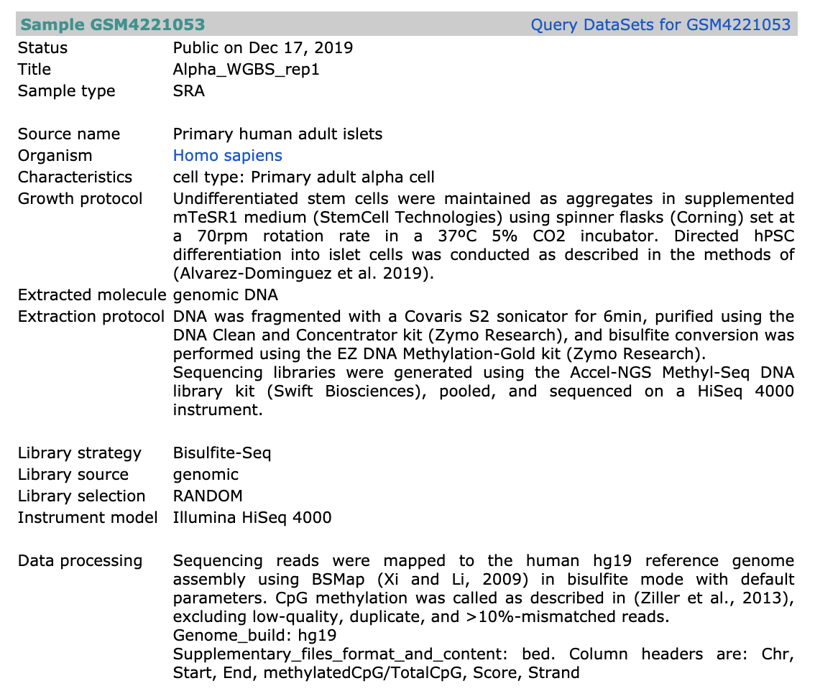

Slide 4
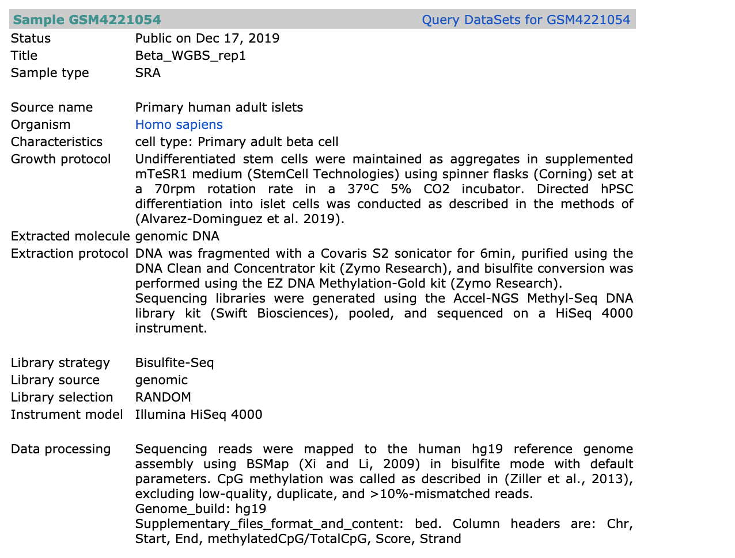

Slide 5
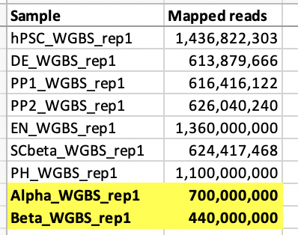
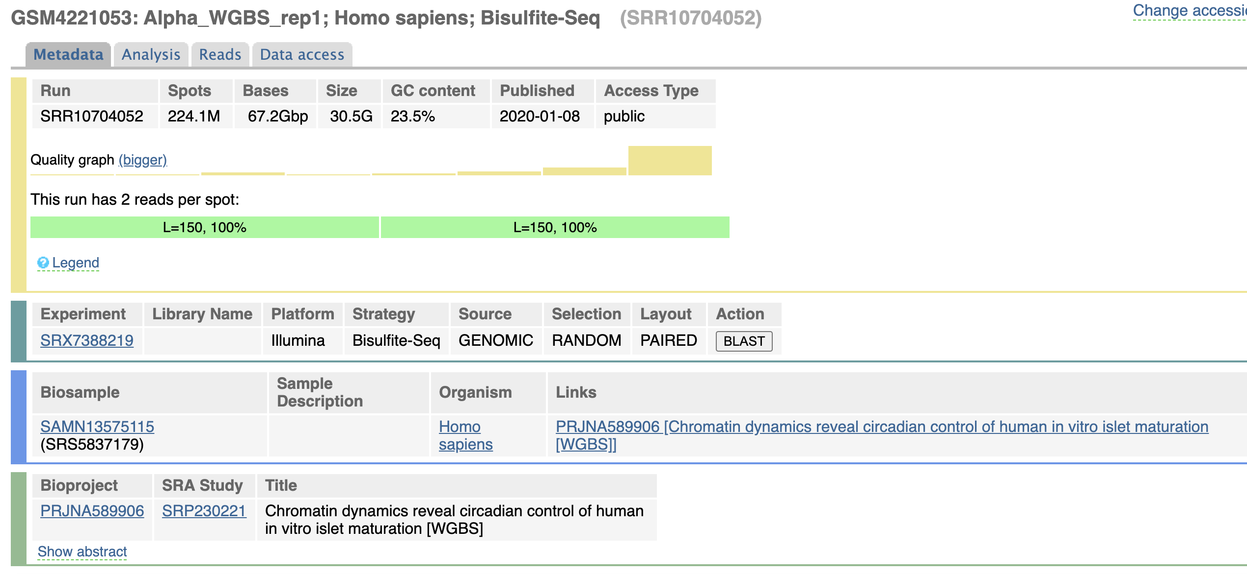
Metadata – Alpha cells

Slide 6
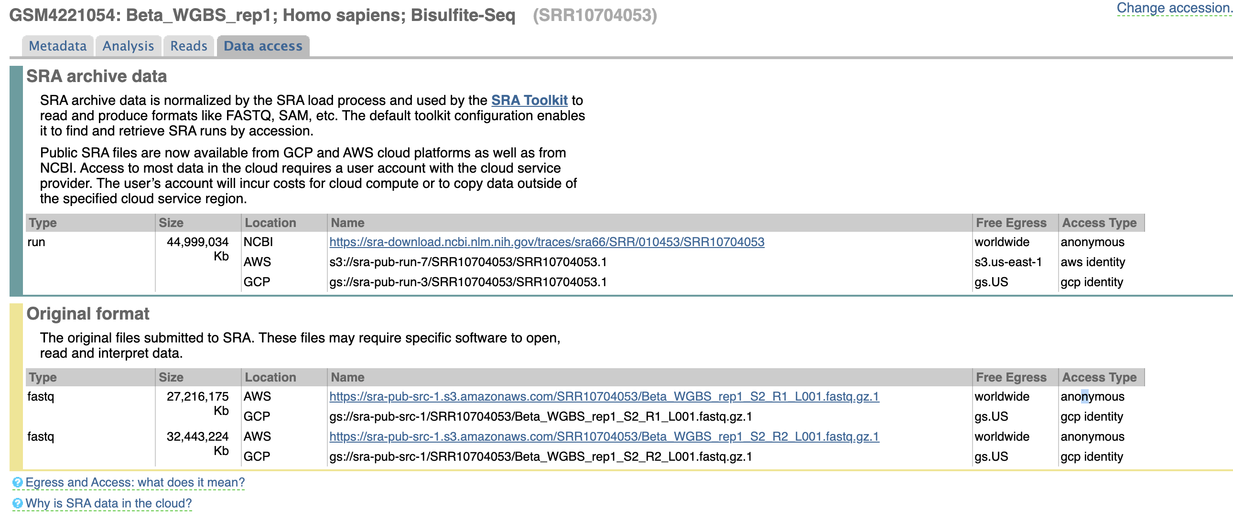
Metadata – Beta cells

Slide 7
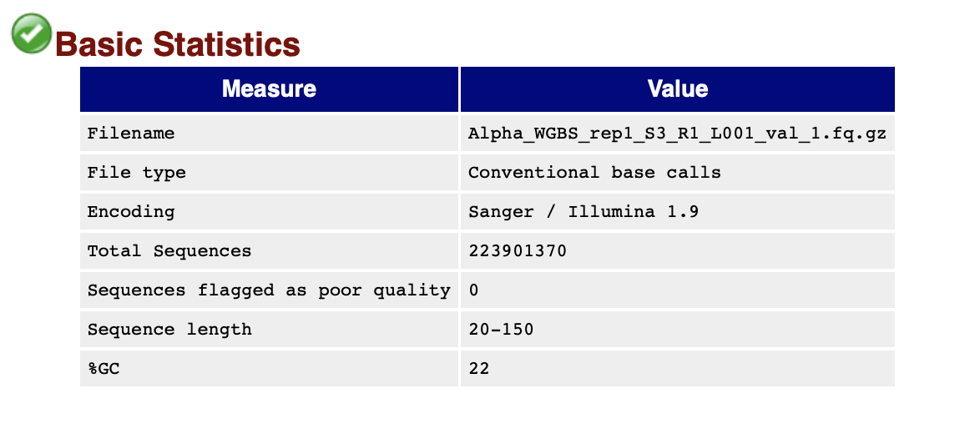
FastQC Report – Read 1, Alpha
Notes:
https://dnacore.missouri.edu/PDF/FastQC_Manual.pdf
Per Base Sequence Quality
Median quality value across all bases at each position in the FastQ file was >40
The higher the score, the better the base call
Very good quality (green)
Per Sequence Quality
All sequences had a quality score > or = 26
Per Base Sequence Content
Normally, you would expect that there would be little to no difference between the different bases of a sequence run, so the line in this plot should run parallel with each other
In our case, we are working with bisulfite-converted DNA, so there is a T bias for Read 1 (i.e., T-rich reads), and A bias for Read 2 (i.e., A-rich reads), which are compliments of the T-rich sequences
Per sequence GC content
~20% GC content
Per base N content
No N’s (i.e., unknowns) were called at each position in the read

Slide 8
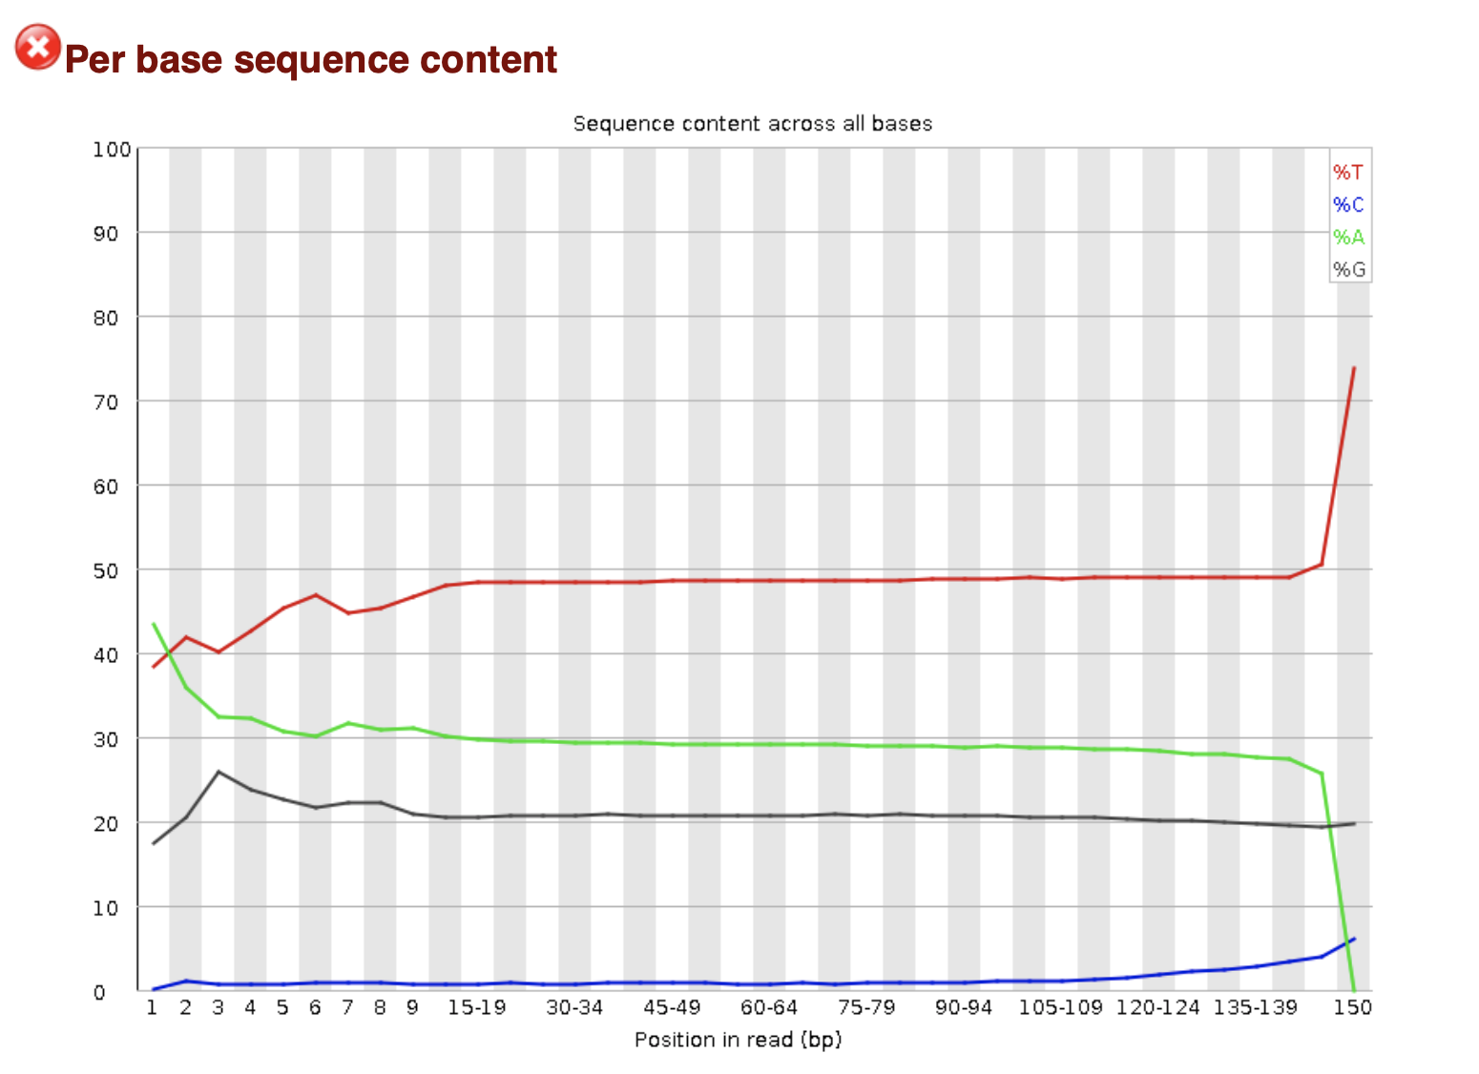
Per base sequence content – Read 1, Alpha
All non-CpG C’s were converted to U’s, which are then incorporated as T’s during PCR amplification
Results in High T, low C content
Across all positions , ~50% of sequences have a T

Slide 9
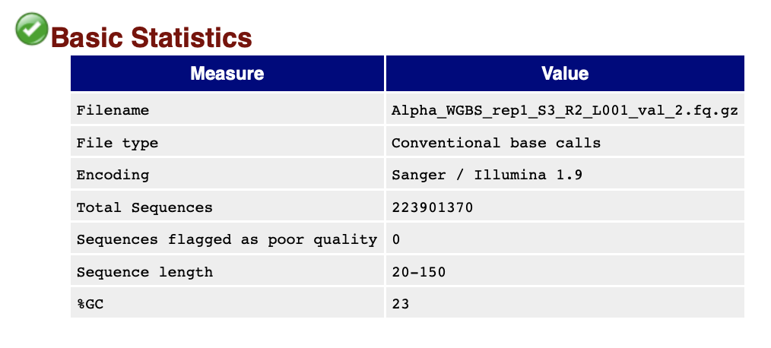
FastQC Report – Read 2, Alpha

Slide 10
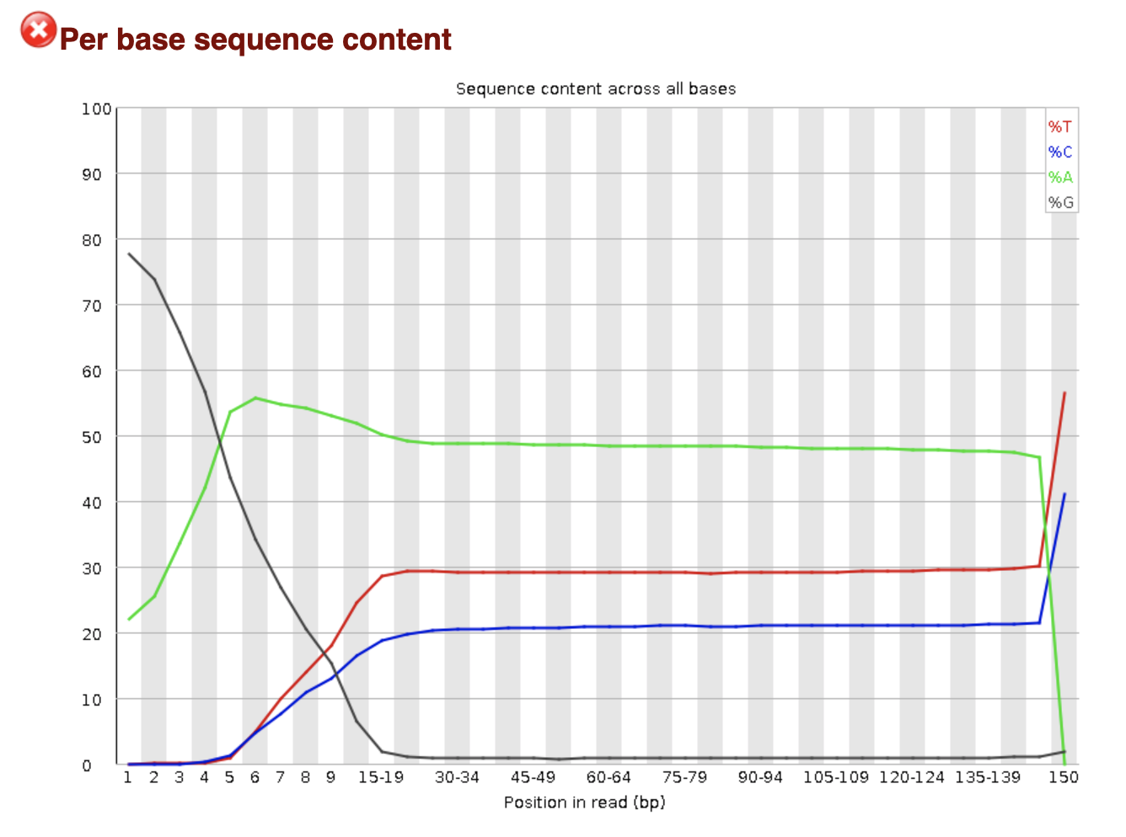
Per base sequence content – Read 2, Alpha
Read 2 includes sequences that are compliments of Read 1 (T-rich sequences) and are therefore enriched for A’s
Results in high A content
Across most positions , ~50% of sequences have an A

Slide 11
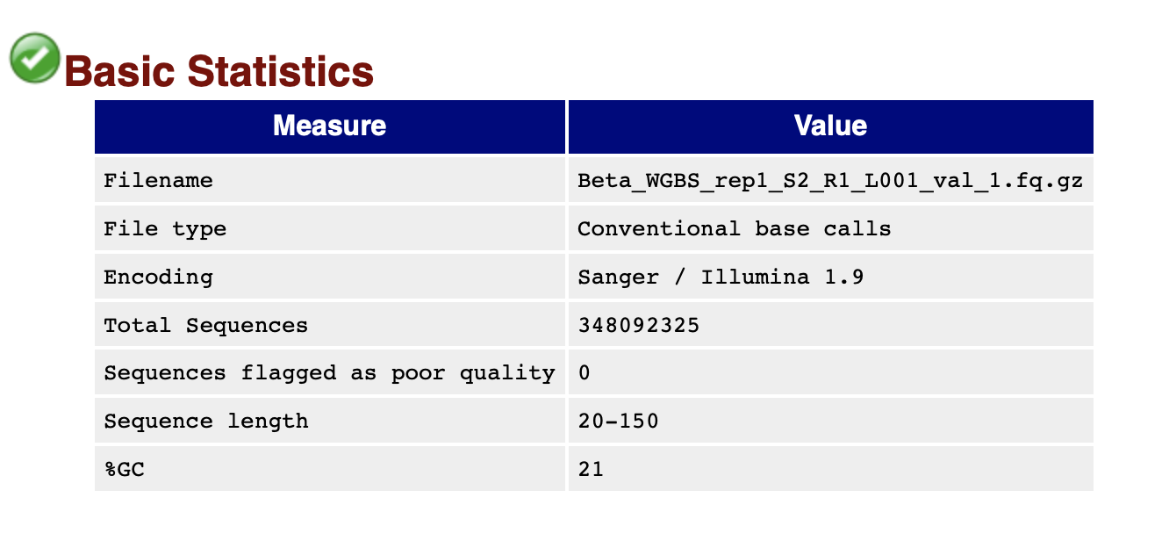
FastQC Report – Read 1, Beta

Slide 12
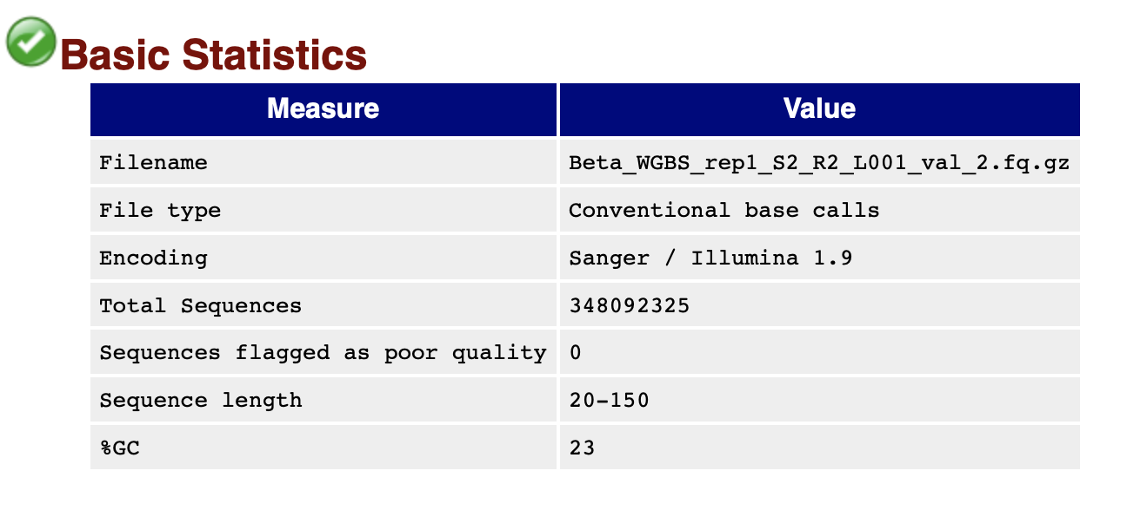
FastQC Report – Read 2, Beta

Slide 13
Number of paired-end reads should be the same
[aganve@gw344 aganve]$ cat counting_lines_alpha_beta-23093309.out
Wed Aug 19 17:30:52 CDT 2020
/data/hodges_lab/aganve/data/DNA_Methylation/2_trimmed_reads
350226515 Alpha_WGBS_rep1_S3_R1_L001_val_1.fq
895605480 Alpha_WGBS_rep1_S3_R2_L001_val_2.fq
Alpha_WGBS_rep1
1392369300 Beta_WGBS_rep1_S2_R1_L001_val_1.fq
1392369300 Beta_WGBS_rep1_S2_R2_L001_val_2.fq
Beta_WGBS_rep1

Slide 14
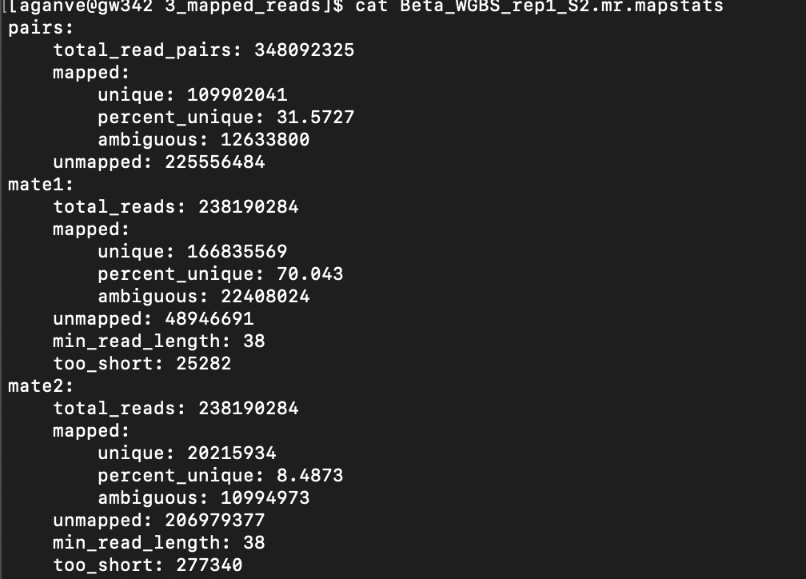
Map stats – Beta cells
Notes:
“Mapstats” files includes the total number and proportion of reads mapped, how many paired end mates were mapped together, and the distribution of fragment lengths computed by the matched pairs

Slide 15
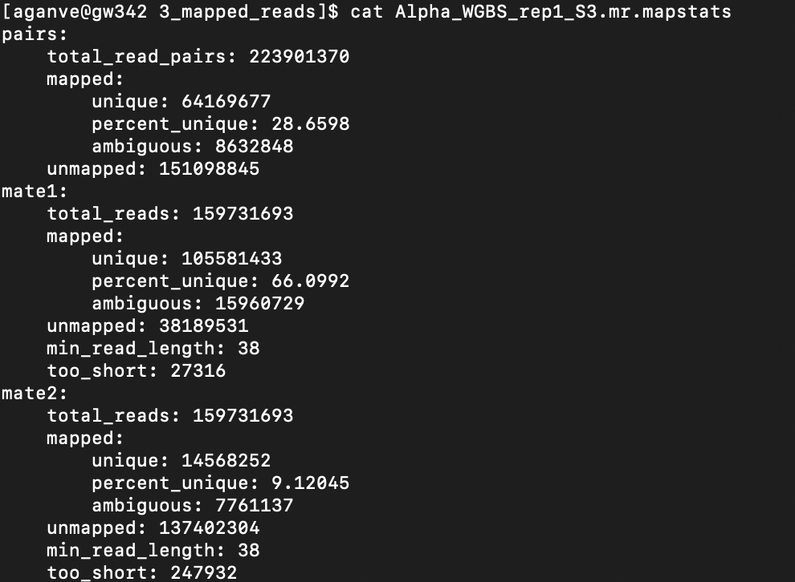
Map stats – Alpha cells

Slide 16
Removing duplicates
Before calculating methylation level, read duplicates are removed, or reads that were mapped to identical genomic locations (same chromosome, smart start and end, and same strand)
These reads are most likely the results of PCR over-amplification rather than true representations of distinct DNA molecules
The program duplicate-remover removes such duplicates and chooses a random one to be the representative of the original DNA sequence

Slide 17
Removing duplicates
-rwxrwx--- 1 aganve hodges_lab 115G Sep 11 02:57 Beta_WGBS_rep1_S2.mr.sorted_start
-rwxrwx--- 1 aganve hodges_lab 90G Sep 15 19:41 Beta_WGBS_rep1_S2.mr.dremove
-rwxrwx--- 1 aganve hodges_lab 70G Sep 11 02:49 Alpha_WGBS_rep1_S3.mr.sorted_start
-rwxrwx--- 1 aganve hodges_lab 53G Sep 15 10:25 Alpha_WGBS_rep1_S3.mr.dremove

Slide 18
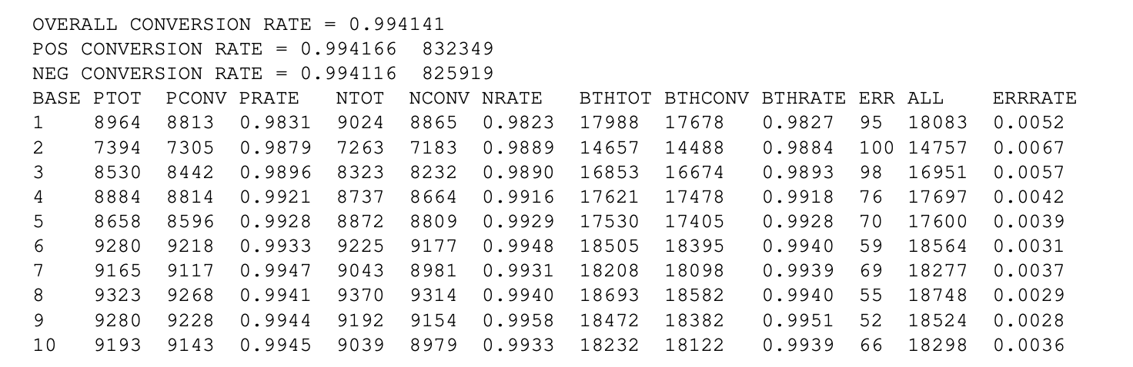
Estimating bisulfite conversion rate
An underestimate because we assume any read with either a C or a T contains no error
PTOT = total nucleotides used
PCONV = the number converted
PRATE = rate of these two, for the positive-strand mappers
The corresponding numbers are also given for negative strand mappers (NTOT, NCONV, NRATE)
Combined = BTHTOT, BTHCONV, BTHRATE
Measuring the bisulfite conversion rate this way requires some kind of control set of genomic cytosines not believed to be methylated. Use non-CpG cytosines which are believed to be almost completely unmethylated in most mammalian cells. In general the procedure is to identify the positions in reads that correspond to these presumed unmethylated cytosines, then compute the ratio of T to (C + T) at these positions. If the bisulfite reaction was perfect, then this ratio should be very close to 1, and if there is no bisulfite treatment, then this ratio should be close to 0
Notes:
POS CONVERSTION RATE refers to the conversion rate for positive strand mappers, i.e., bisulfite conversion rate in file_1, or T-rich reads (T to C+T ratio). Total number of nucleotides used is given, and numbers for pos and neg strands should be similar
NEG CONVERSION RATE refers to the conversion rate for negative strand mappers, i.e., bisulfite conversion rate in file_2, or A-rich reads (T to C+T ratio). Total number of nucleotides used is given, and numbers for pos and neg strands should be similar
The information is presented separately because this is often a good way to see when some problem has occurred in the context of paired-end reads. If the conversion rate looks significantly different between the two strands, then we would go back and look for a mistake that has been made at an earlier stage in the pipeline.
The bisulfite conversion rate reported in MethBase is computed from all non-CpG cytosines, and assumes zero non-CpG methylation. Because this is likely not true, we report a conservative estimate of conversion rate

Slide 19
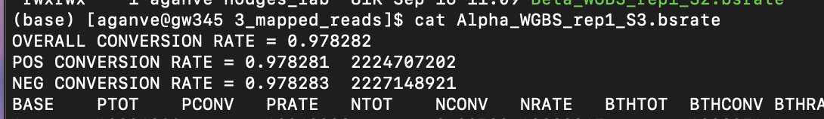
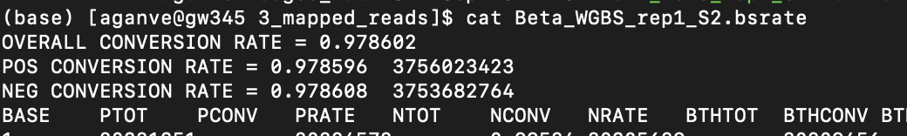
Estimating bisulfite conversion rate: Alpha & Beta

Slide 20
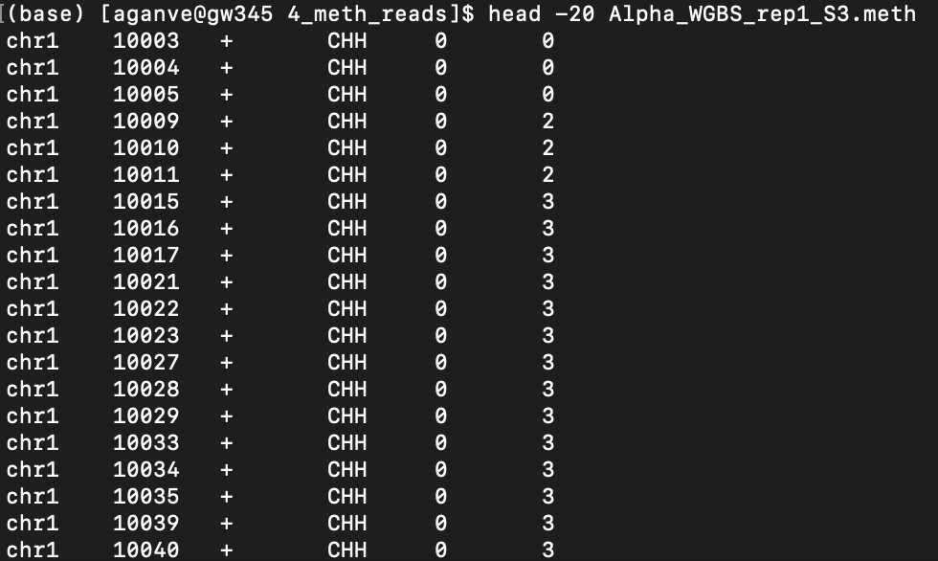
Computing single-site methylation levels for all C’s in both CpG and non-CpG contexts
It is recommended that users allocate at least 8GB of memory when running methcounts
H = adenines, thymines, or cytosines
X = adenines or thymines
Notes:
The output file contains one line per cytosine site. The first column is the chromosome. The second is the location of the cytosine. The 3rd column indicates the strand, which can be either + or -. The 4th column is the sequence context of that site, followed by an x if the site has mutated in the sample away from the reference genome. The 5th column is the estimated methylation level, equal to the number of Cs in reads at position corresponding to the site, divided by the sum of the Cs and Ts mapping to that position. The final column is number of reads overlapping with that site.

Slide 21
Size filter, then cross ref vs RefSeq TSS/Exons
Before filtering for HMRs that are >= 50 bp:
Beta: 63465
Alpha: 54387
After filtering for HMRs that are >= 50 bp:
Beta: 63395 (-70)
Alpha: 54330 (-50)
After NCBI RefSeq filter step that removes TSS and exons:
Beta: 14522 (-48,873)
Alpha: 5787 (-48,543)
After running bedtools intersect to identify beta-cell specific HMRs and vice-versa:
Beta: 14522 (-0)
Alpha: 5787 (-0)
No shared HMRs?
Notes:
HMRs at promoters are shared between many cell types

Slide 22
No filtering for TSS/Exon/Size
Before bedtools intersect to identify beta-cell specific HMRs and vice-versa:
Beta: 63465
Alpha: 54387
After running bedtools intersect to identify beta-cell specific HMRs and vice-versa:
Beta: 15874 (-47,591)
Alpha: 6332 (-48,055)
After running bedtools intersect to identify shared HMRs across beta and alpha cells:
48055
40320 of the 48055 shared HMRs are actually HMRs (not TSS/Exons) using filter step for RefSeq

Slide 23
Filter for TSS/Exon but not Size
Before filtering for TSS/Exon:
Beta: 63465
Alpha: 54387
After filtering for TSS/Exon:
Beta: 14548
Alpha: 5798
After running bedtools intersect to identify beta-cell specific HMRs and vice-versa:
Beta: 14548
Alpha: 5798
After running bedtools intersect to identify shared HMRs across beta and alpha cells:
0

Slide 24
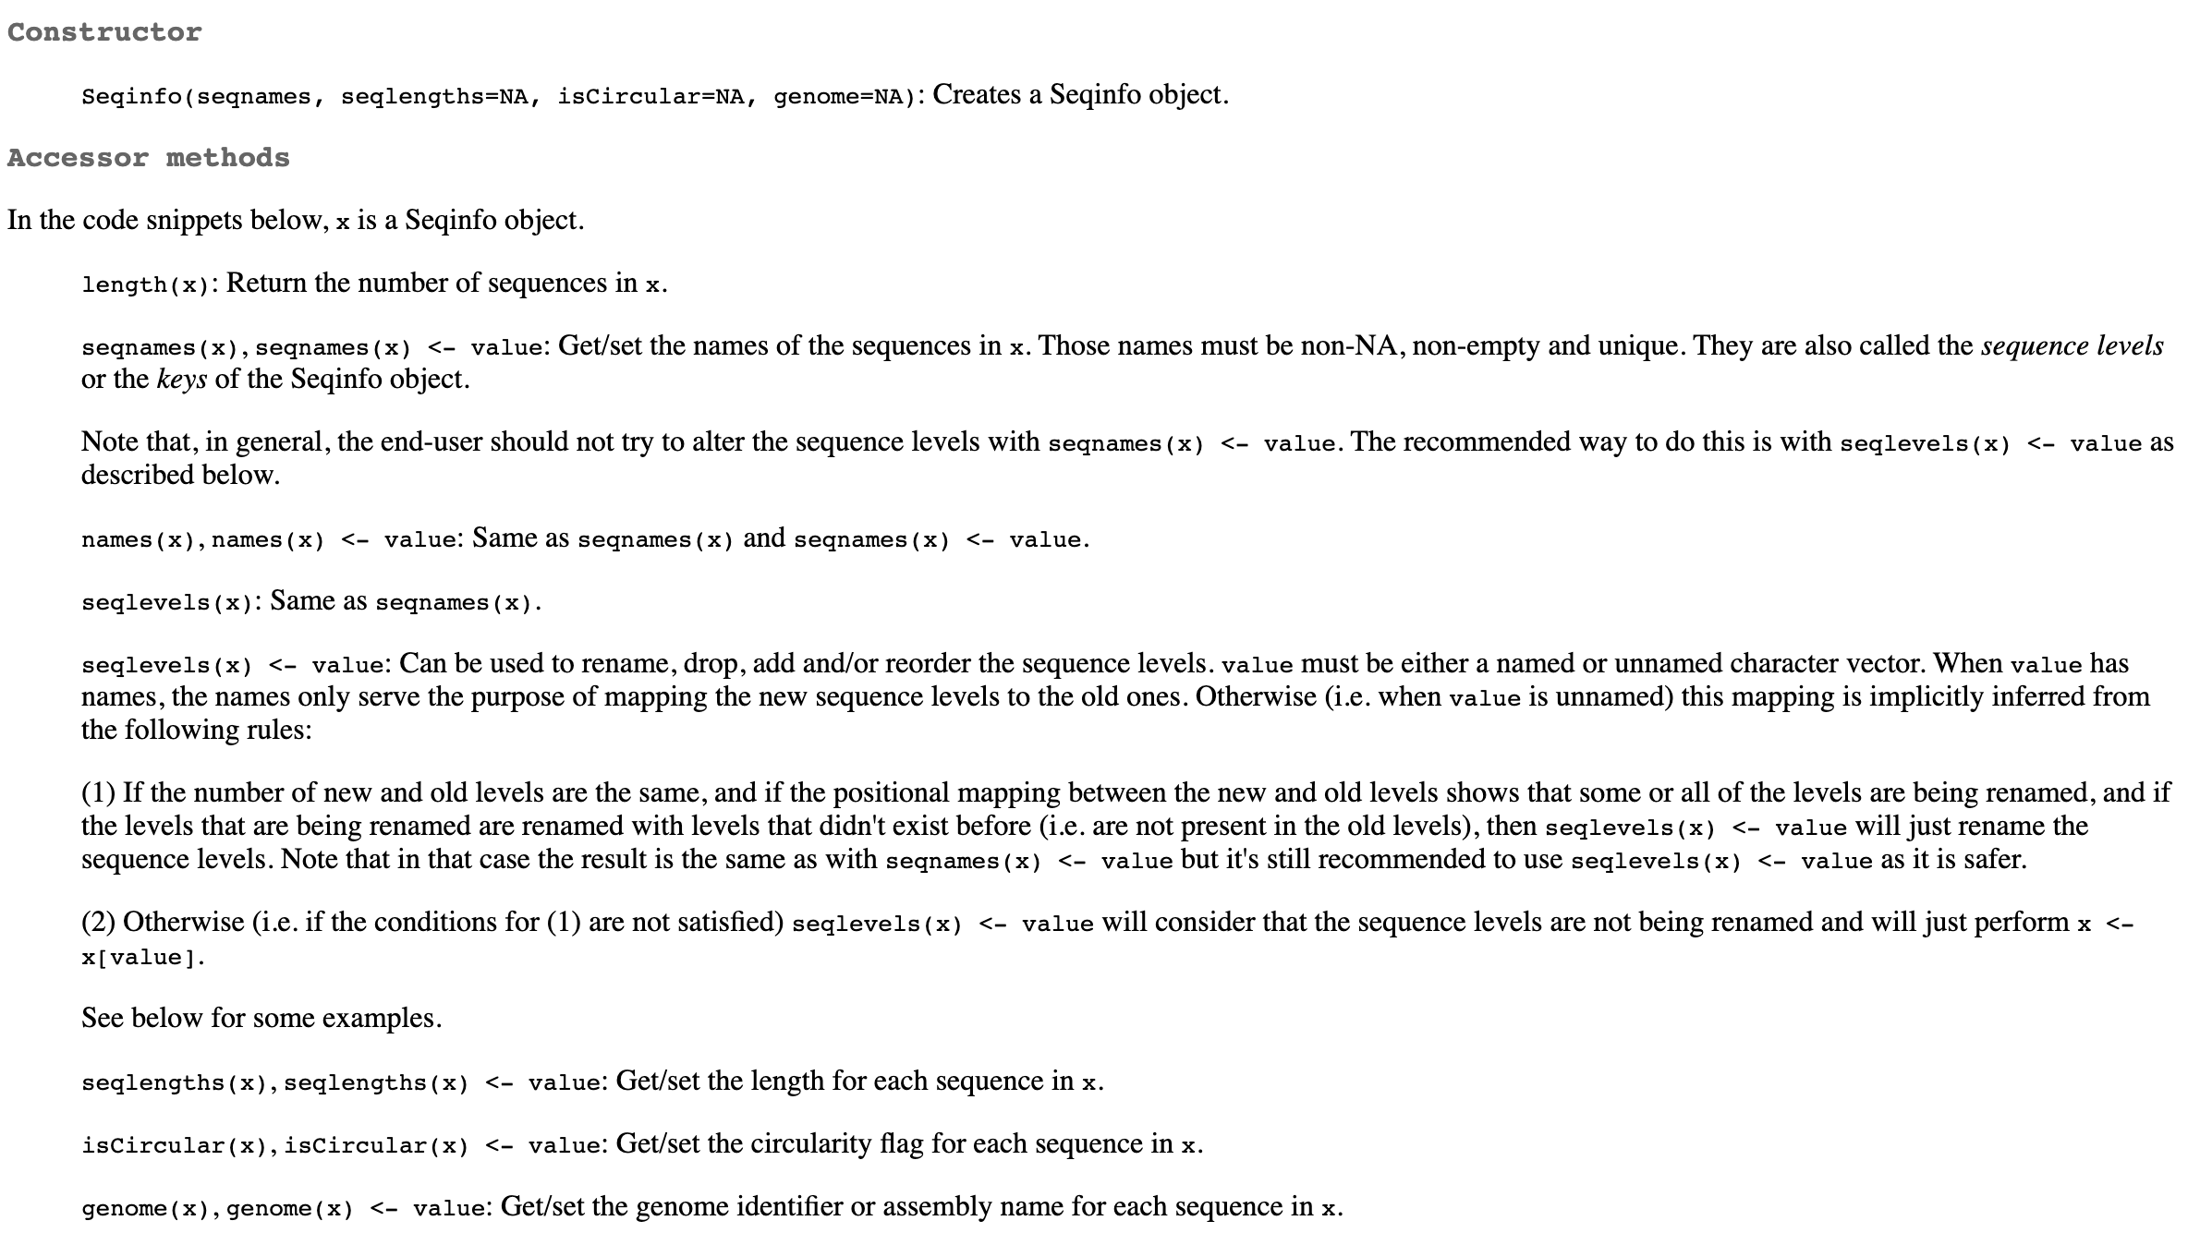
seqinfo() function with Granges package

